Slide 1

IIITH Models.. Customer Discovery
Week 6

Slide 2
OUTLINE
W1-Ideas
Evaluating Ideas 101
Idea Stretching (& pick one)
W2- Idea reviews
W3-Problem
Who. Why. What. When
Present alternatives. Gaps
W4- Solution
How. Why better.
W5- Value proposition
Differentiation?
W6
hack
pitch
pitch
W7- Frameworks/Models
Lean canvass;….
W8- Customer discovery
Who are the customers. Customer env
Segments. .
W9- Design thinking
User centric thinking
W10- Competition & USP
W11- Review with Center faculty
.
W12
hack
pitch
pitch
W13- Customer Development
W15- Biz Plans
W16- Tech Architecture
W17- Pitch Basics
W14- Revenue models
GTM plans et al
Chasm framework
W18
PITCH
pitch
pitch
pitch
DEMOP
Notes:
OLD OUTLINE
Introduction
Technology Product innovation.
Successful products cases review
Creativity & Innovation
Stretch the idea. Idea Hexagon framework applied
Frameworks & Models
Product & Market first
Vision first (Vision/Strategy/Execution)
Large opportunity (Big untapped market/ Much better product/ Much better team)
Lean Startup models
Crossing the chasm”
Customer Discovery/Opportunity mapping
LEAN Startup methodology
Business Model canvass Tool
Design Thinking
Design thinking process: understand, observe, define, ideate, prototype, test
Customer Development
parallel process to product development for sales, marketing and business development
Market & Competitive Positioning
Sales & Market Strategy
Go to Market avenues, and projections
GTM Planning
Business Plans
Creating, developing and evaluating the Technology Product’s “concept of a business”
Technical Architecture considerations
Leveraging Mobile and Cloud
Corporate Technology Innovation
Applying research technology in corporate environments
Tech Product Pitch/Plan presentations
What makes a good product pitch and demo

Slide 3
Incrementally build your startup
Students will apply the learning on your tech product idea and create a venturable product and plan; in a workshop mode thru extensive hands on assignments concurrent with course modules..
Introduction : Assignment: Create startup website; Vision; Basic Positioning statement;
Creativity & Innovation: Assignment: Based on team’s tech idea considered, list 3 product possibilities, applying Idea hexagon framework.
Frameworks & Models: Assignment: Assess opportunity for the ideas. And pick the “venturable business.”
Customer Discovery/Opportunity mapping: Assignment: Apply Lean Startup Methodology, and Validate customer interest, need & … ; Assignment: First cut of Musiness Model Canvass filled in
Design Thinking: Assignment: Rapidly create and refine the product functionality for the teams product using design thinking process
Customer Development: Assignment: Competitive Positioning; Assignment: Update Product functionality capturing the competitive proposition
Sales & Market Strategy: Assignment: Evolve the GTM plans
Business Plans: Assignment: Completed, defensible, business model canvass; Assignment: Product roadmap- market & technical, GTM plans, revenue projections
Technical Architecture considerations: Assignment: Study 2 similar solutions in market and compare/contrast tech architecture used by your product
Tech Product Pitch/Plan presentations

Slide 4
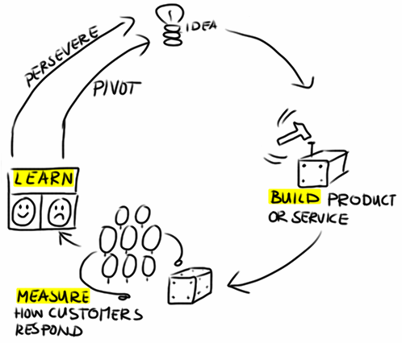
So, what do you do?
For the mkt Hypothesis, list specifics (who, why, what)
Build product prototype
Reach out to specific target group
Ask to validate hypothesis (if they agree)
Get feedback & Analyse
For each hypothesis
Market hypothesis (who and why will they buy)
ITERATIVELY evolve

Slide 5

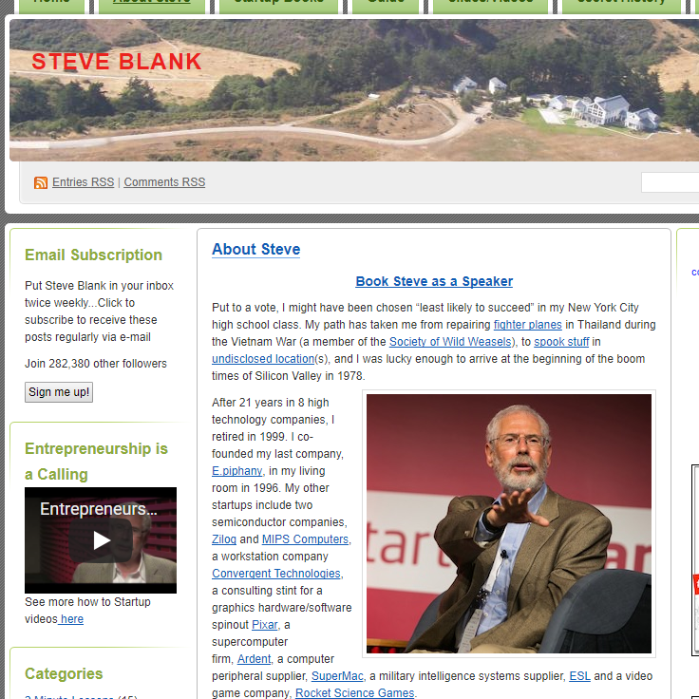
LSM based Customer Validation ..

Slide 6
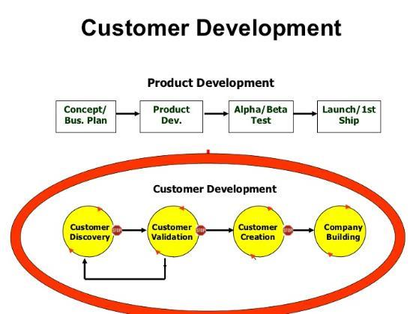
Steve Banks’ LSM

Slide 7
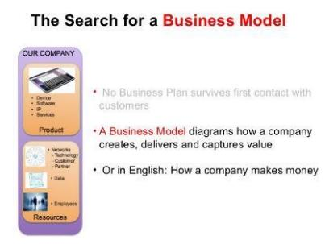
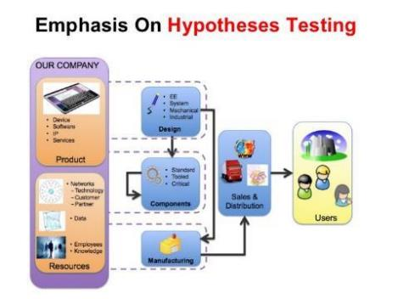
Customer Development is SEARCH for a Biz Model

Slide 8
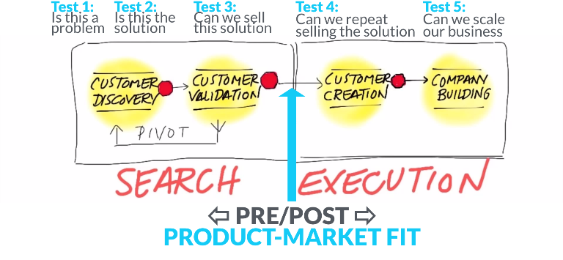
What we need to find

Slide 9
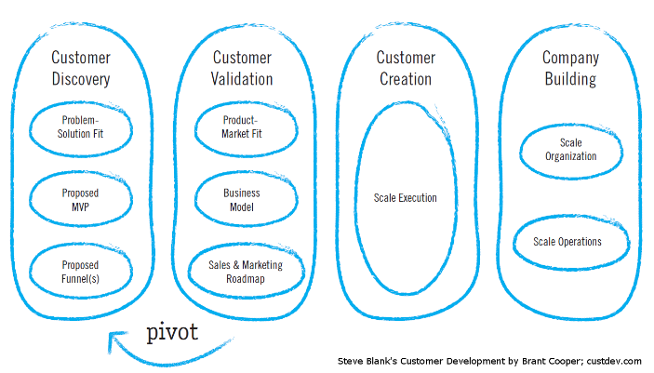
Elements of Customer Development

Slide 10
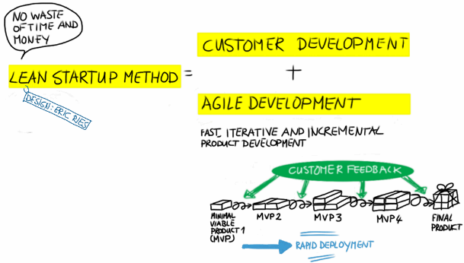
Customers <> Product
Customer Discovery & Product Development.. in Parallel
Test UNKNOWNS in Biz Model
Measure- prototypes & real (product)
Rapid iterations

Slide 11
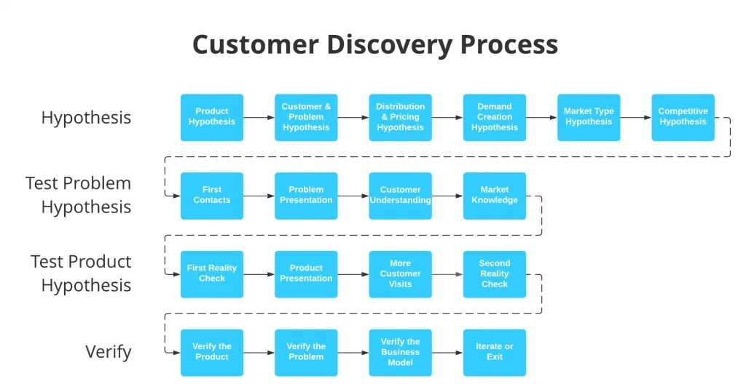

Slide 12
Step One: Define a Hypothesis
The first step is to form a hypothesis that defines both the problem and the solution you are proposing. A simple way to frame this is to fill in the following sentence:
My idea solves [insert problem] by [insert solution].
A word of warning: pay very close attention to your assessment of your problem. Be as specific as possible.
A good hypothesis addresses a single problem with a single solution.
For example: Instead of saying, “My idea solves people’s need to do laundry by offering a laundry delivery service,” a better idea hypothesis might be, “My idea solves the inconvenience and large time commitment of maintaining clean laundry by offering a 24-hour convenient laundry delivery service.”
The first addresses a vague problem that does not match the solution (a laundry service doesn’t solve the need for clean laundry), while the second directly addresses the heart of the issue and matches it with a corresponding solution.

Slide 13
Validating your hypothesis
DETECTIVE phase..
Creatively define your survey
NOT seek people’s thoughts on your idea
Without mentioning your idea, “find” customers needs to validate your hypothesis
Customer Discovery allows you to let your customers build your product for you.
What questios
Open-ended and nonspecific, about your idea. But specific questions.
Example questions might include:
Tell me how you currently do _____________________.
How is that process working for you?
If you could do anything to improve your experience with ___________________, what would it be?
What’s the hardest part about ______________?
What do you like/dislike about ______________?

Slide 14
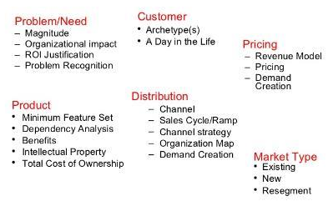
Customer Discovery- thru Hypothesis testing
Don’t rush to sell. Start LISTENING
LIST & TEST mkt hypothesis..
At end, get..
Customer segments
Top Problems
Users & uyers understanding

Slide 15
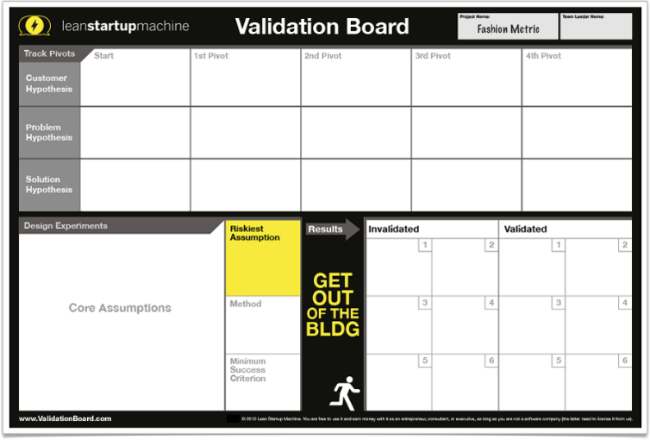
Testing Tool

Slide 16
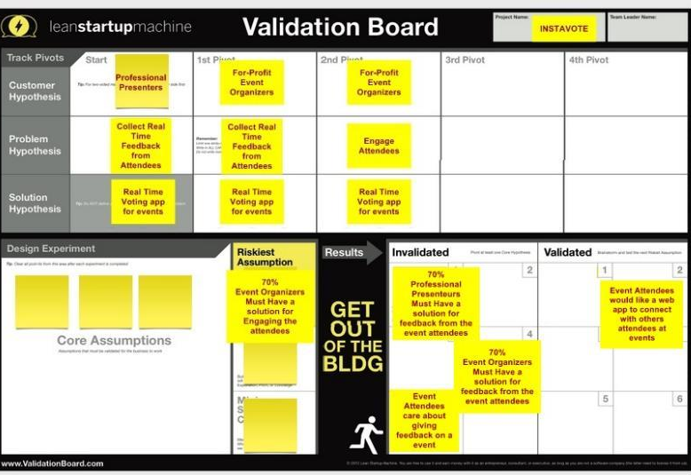
Example

Slide 17
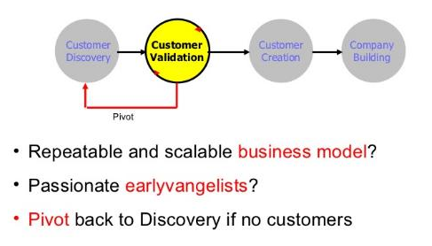
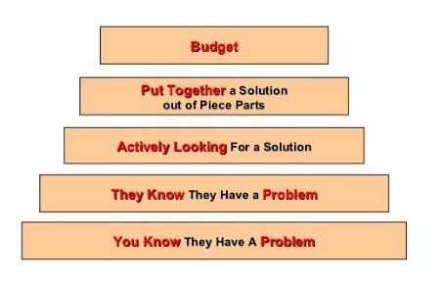
Customer Validation
Locate Winning Customers

Slide 18
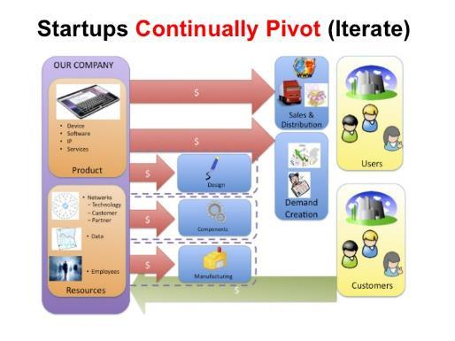
Iterate. Pivot. >> CUSTOMER PLAN, VALIDATED
Validation Outcome
Biz Model
Understand Sales cycle (who, what value prop,..)
Proven Customer acquisition model (who/how)
Initial orders validating

Slide 19
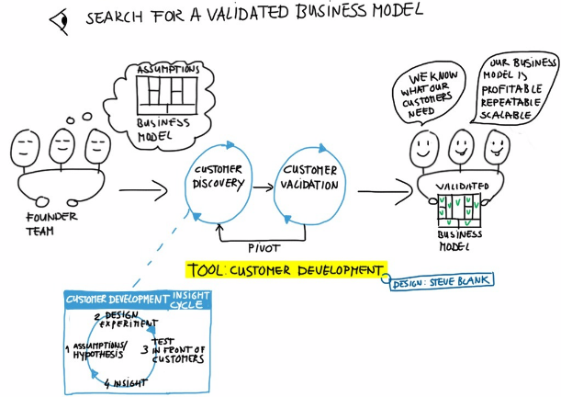
Customer Validation, results in a biz model

Slide 20
ANNEXURE

Slide 21
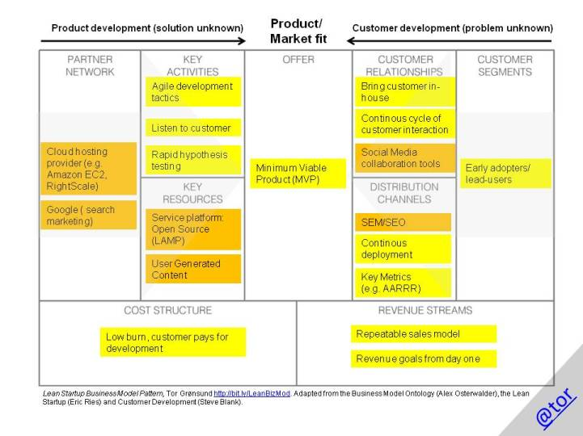
Biz Model

Slide 22
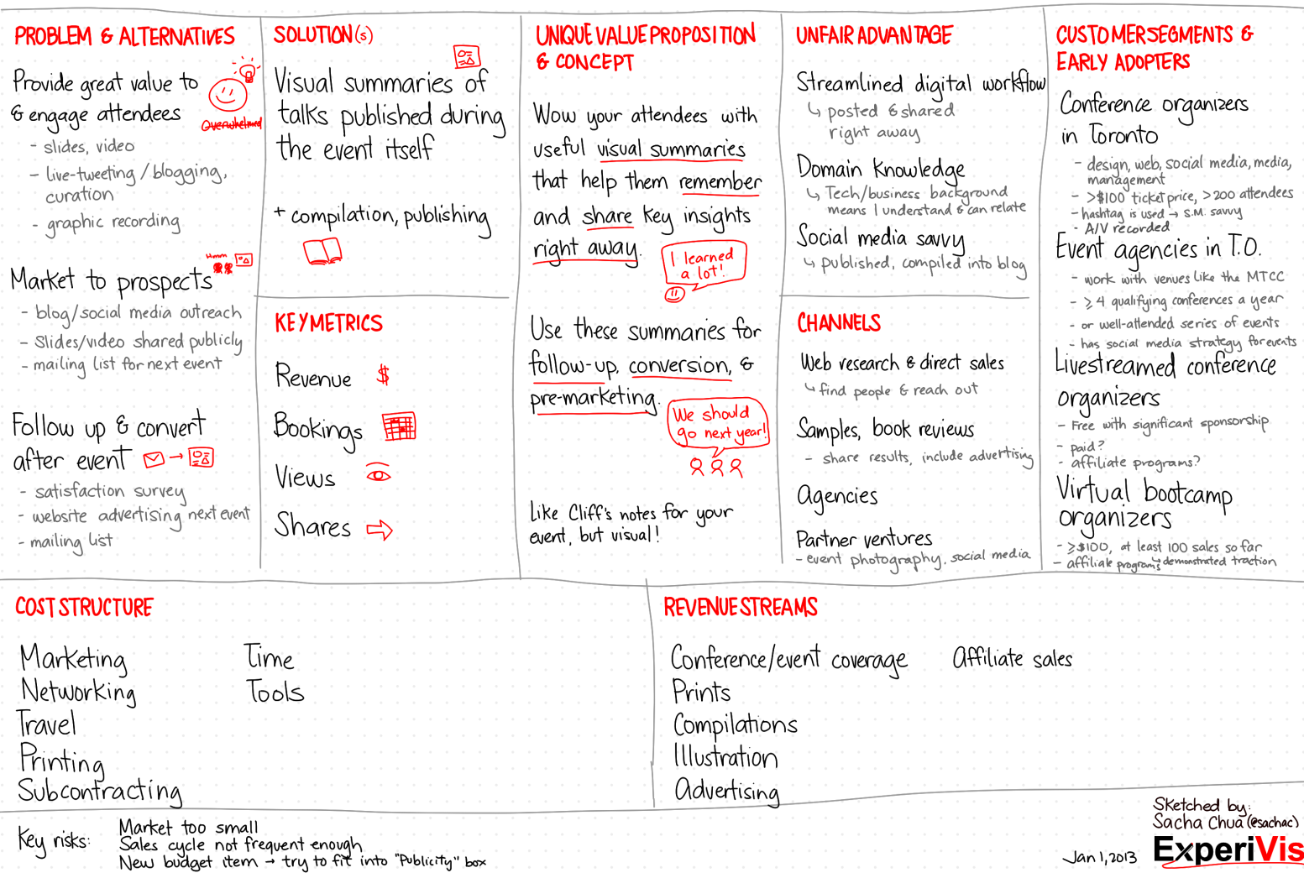
Lean Canvass- example

Slide 23
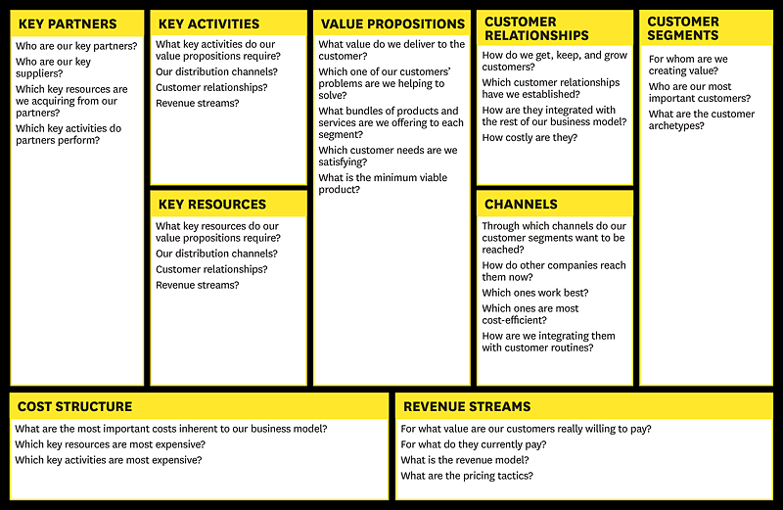
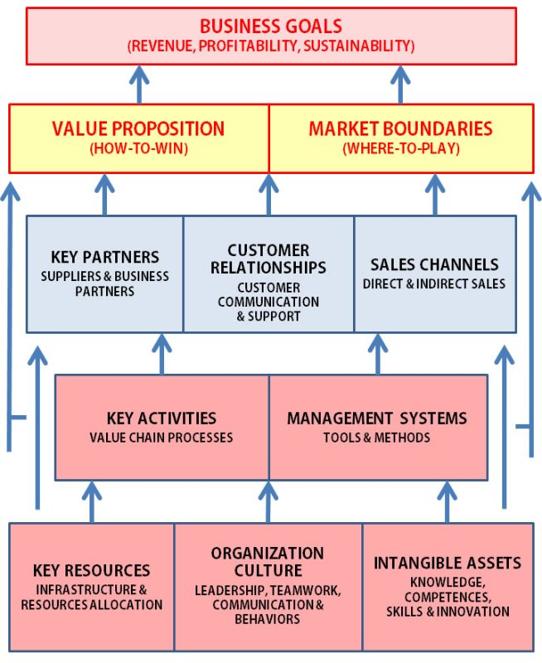
Business Model Canvass

Slide 24
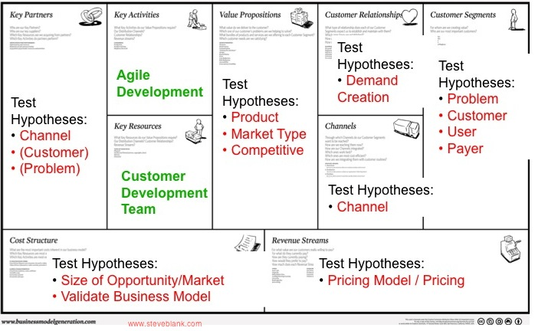
Assignment: Biz Model Canvass
Create Biz Model canvass
Should be clear and compelling

